Slide 1



Module-4(b) Thermal Expansion of solid material
ESO205: Nature and Properties of Materials
By- Pragya Dixit, Research Scholar
Aim:
To study the thermal expansion behavior of solid materials using a dial gauge dilatometer.

Slide 2
Theory:
Repulsion Energy
(B/r^{n} )
(Energy)
(Interatomic distance)
r
0
r₀
Total Energy
r_{2'}
r_{2"}
r₂
T₂>T₁
Total potential energy
V(r) =( - (A/r^{m} ) + (B/r^{n} ))
Decreasing r lowers the energy
r_{1'}
r_{1”}
T₁
r₁
Attraction Energy
(A/r^{m} )
Figure: Potential energy Vs Interatomic distance

Slide 3
Asymmetric shape of the potential energy curve can be noticed.
Degree of asymmetry is a function of the values of the exponent of m and n in equation.
m<n
In ionic crystals, m ~1 and n ~ 12, here m = 1 corresponds to coulomb attraction between two point charges.
In molecular crystals, m ~ 6.
At temperature T₁ and energy E₁, the r oscillates from r ₁‘ to r ₁“.
r ₁ = (r ₁‘ + r ₁“)/2
At temperature T₂ > T₁ and energy E₂ , r oscillates from r ₂‘ to r ₂“.
r₂ = (r ₂‘ + r ₂“)/2
At T₂, r₂>r₁ leads to thermal expansion.

Slide 4
Asymmetric shape of the potential energy curve (due to anharmonic nature of the lattice vibrations) is responsible for the thermal expansion.
Large binding energy high melting point of a material
Have a deep potential energy minimum
At T<<<Tm, asymmetry of the curve exist only to a small extent.
A material with a high melting point (T ° K) would, near room T shows low thermal expansion.

Slide 5
Isotropic materials (ex: metals, glass, plastics ):
Exhibit the same thermal expansion in all directions.
Non isotropic crystals (ex: wood, composites):
Possess different Th. Exp. values in various directions.
Poly crystalline specimen (ex: ceramics, ice) :
Has randomly oriented non isotropic crystals so possess avg of expansion coefficient of all the directions.
Multiphase material (ex: Steels, composites)
Has weighted average of the expansion coefficients of its component phases.
Thermal expansion coefficient can be measured by knowing two physical quantities:
Displacement
Temperature

Slide 6
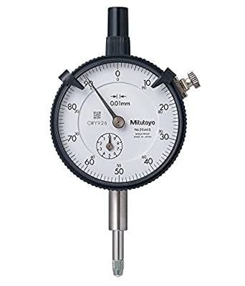
Objective To study the thermal Expansion behaviour of solid material using a dial gauge dilatometer
Apparatus
Fused silica tube
Dial gauge dilatometer
Vertical Tube Furnace
Variac (Auto transformer) for power supply
Temperature Controller
Potentiometer
K-type Thermocouple (Chromel-Alumel) and
Specimen (Aluminium), Fireclay bricks
Dial gauge (mechanical magnification)

Slide 7
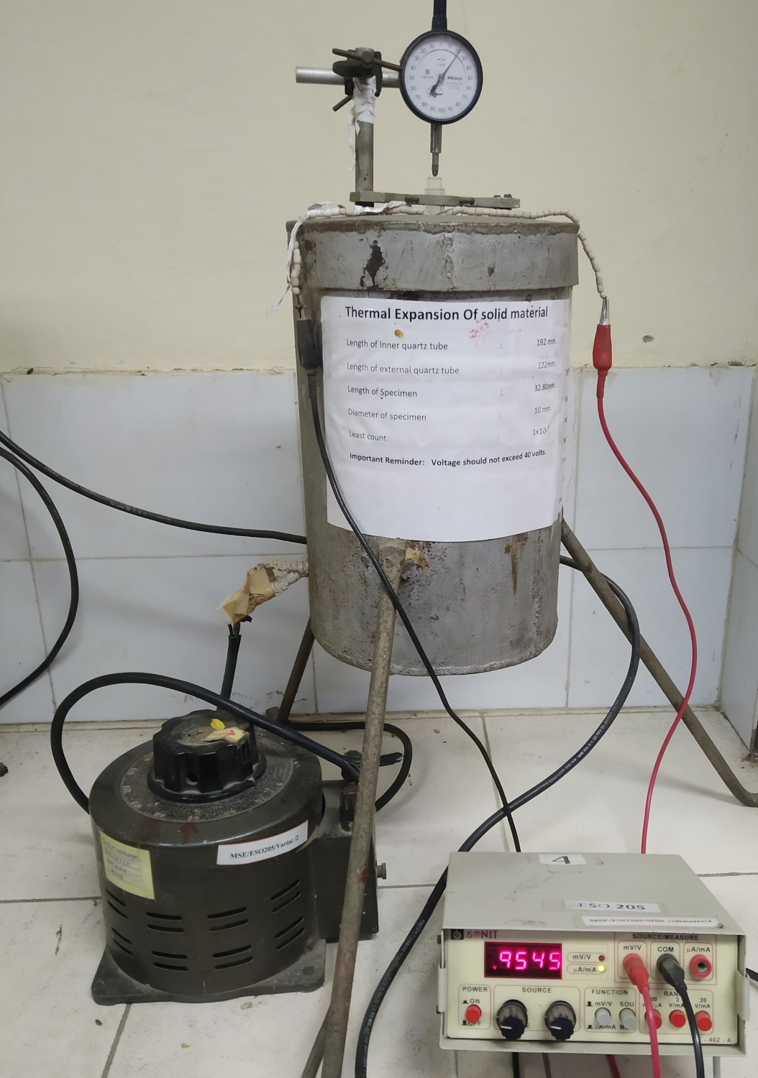
Experimental Setup
Dial Gauge
Specimen tube
Thermocouple
Vertical tube Furnace
Variac
Milli voltmeter

Slide 8
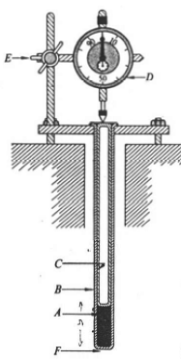
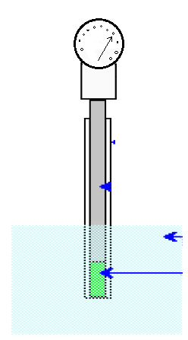
Schematic Diagram & Dilatometer Assembly Experimental Setup
Tighten with clamp
Dial Gauge
Dial gauge
(Least count=0.001mm)
Nut bolt tighten with Inconel plate
Fused Silica Tube
Fused Silica Rod
Fused Silica Rod
Heat Transfer Fluid
Fused Silica Tube
Specimen
Specimen
Alumina tube
Bottom End closed

Slide 9
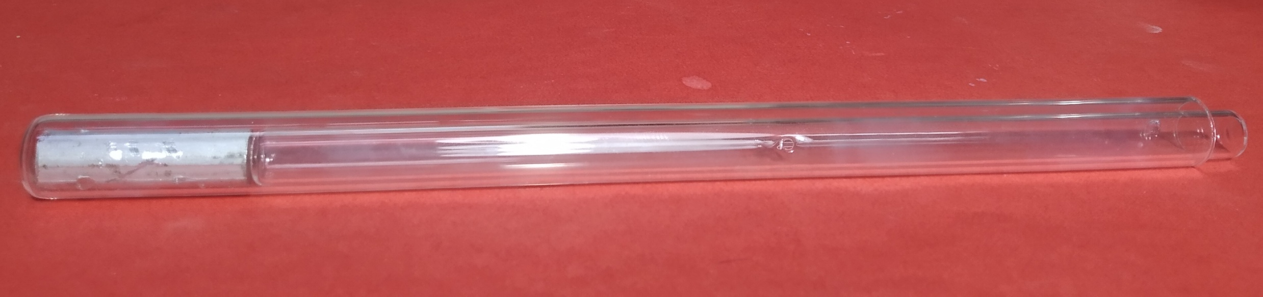
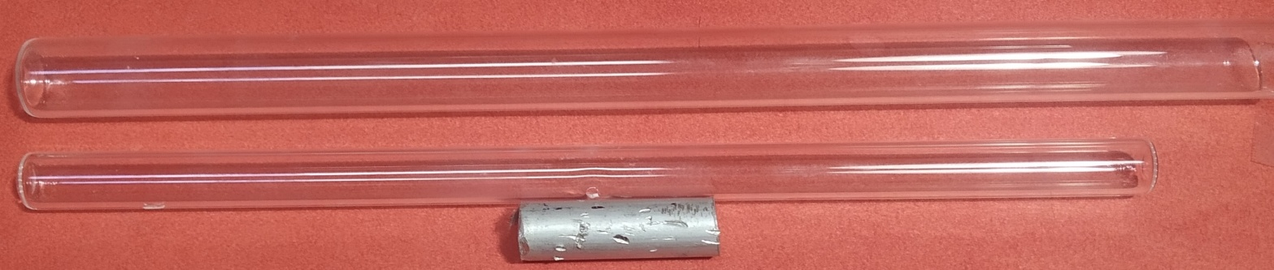
Internal Experimental Design
Specimen( Aluminium )
Outer Tube
Inner tube
Silica Tubes
Outer tube
Specimen
Inner tube

Slide 10
Methodology
Take pure aluminium (why Al?)
Mount one of the samples at the bottom of the quartz tube which is closed at one end
Place the quartz tube on the top of specimen
Attach the dial gauge on the top of outer quartz tube by Inconel clamp
Insert the whole assembly in tube furnace
Read the dial gauge reading at different temperature

Slide 11
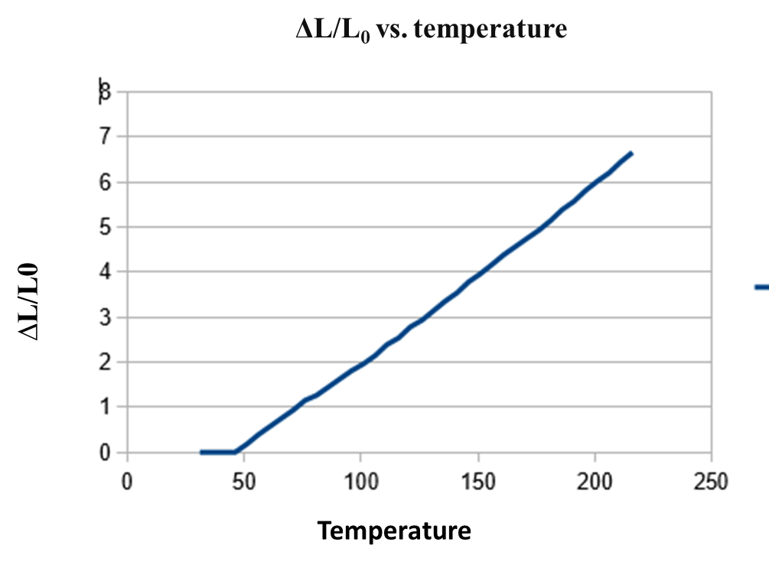
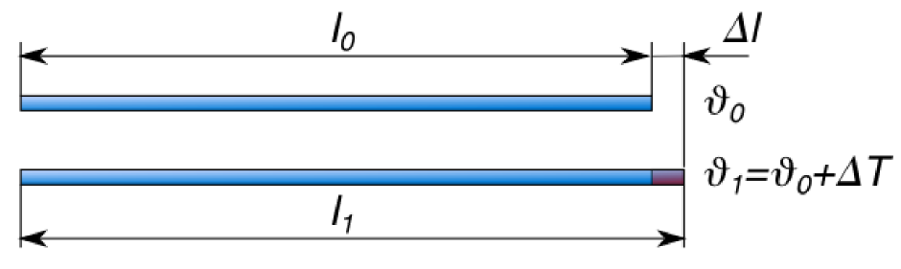
Linear thermal expansion coefficient
The change in length with temperature for solid material can be expressed as follows:
α*△T = (L_{f} -L_{o})/L_{o}
Or
α = (△L)/( △T *L_{o} )
L_{o} and L_{f} are the initial and final length (after heat treatment), respectively.
α is linear thermal expansion coefficient.
△T= T_{f} -T_{o}
Change in length of a rod due to thermal expansion.

Slide 12
Question:
1. Show one adverse effect of differential dilatation (thermal expansion mismatch). Check out your surrounding if you can find any such example (Don’t forget to post a picture of whatever you have observed with proper explanation).
Thank You

